Slide 1
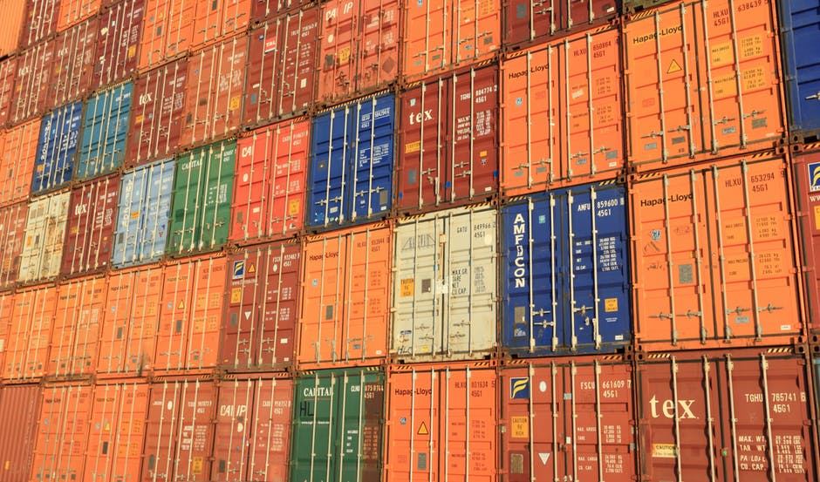
TARIFFS, TRUMP AND TRADE OH MY!
Somjita mitra, Ph.D.
Director, institute for applied economics
Los Angeles County Economic Development Corporation

Slide 2
International Trade
Los Angeles County Economic Development Corporation

Slide 3
Exports of Goods and Services
Los Angeles County Economic Development Corporation

Slide 4
Gains From Trade Theory
Los Angeles County Economic Development Corporation

Slide 5
Tariffs and Imports
1% increase in tariffs
6% decrease in imports
Los Angeles County Economic Development Corporation

Slide 6
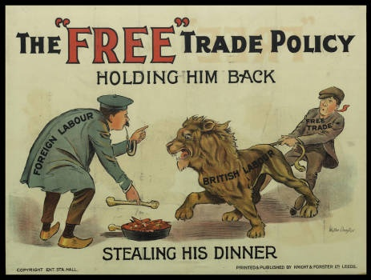
Los Angeles County Economic Development Corporation

Slide 7
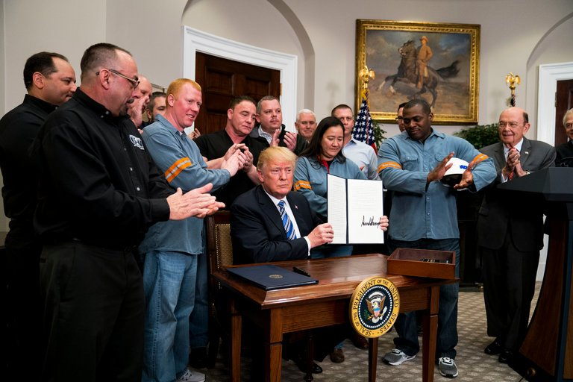
Tariffs!
Los Angeles County Economic Development Corporation

Slide 8
Trade War?
Los Angeles County Economic Development Corporation

Slide 9
TRADE WAR?
What does this mean?
One out of every five tariffs that Trump selected involved a product with the word “parts” in its description
Los Angeles County Economic Development Corporation

Slide 10
TRADE WAR?
U.S. Imports Subject to Tariffs From China
Source: HBR
Los Angeles County Economic Development Corporation

Slide 11
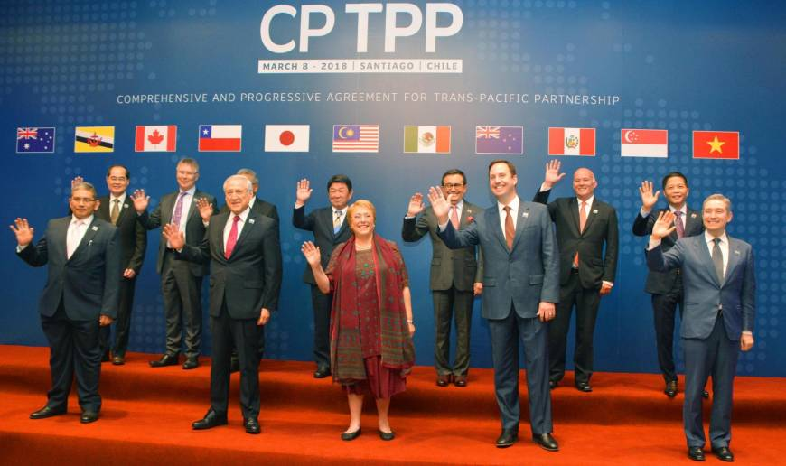
TPP
Trans-Pacific Partnership
Los Angeles County Economic Development Corporation

Slide 12
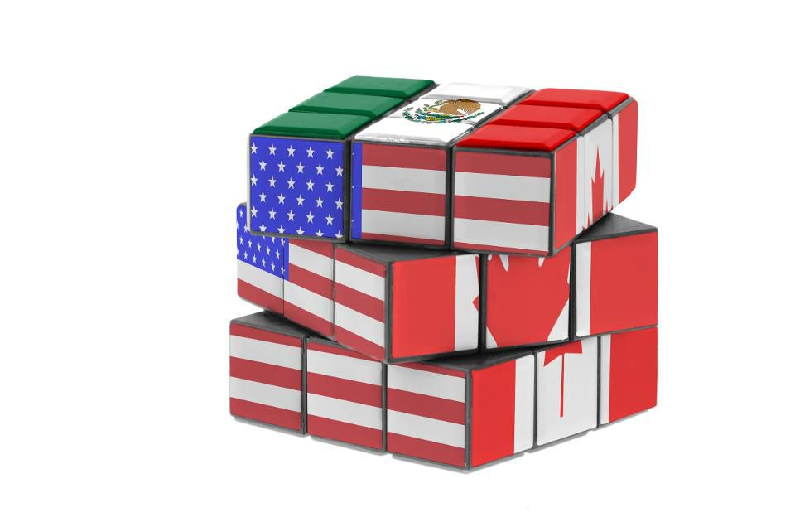
TPP
NAFTA
Los Angeles County Economic Development Corporation

Slide 13
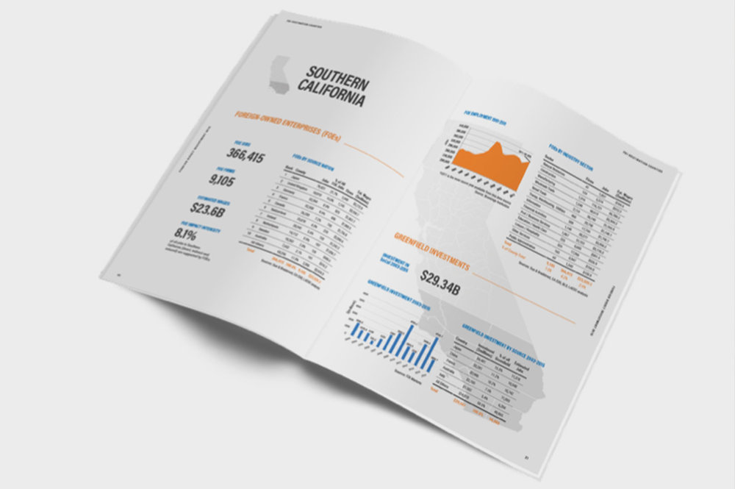
Select LA
May 23-May 24, 2018
SelectLA.org
Los Angeles County Economic Development Corporation

Slide 14
Thank You!
SOMJITA.MITRA@laedc.org
(213) 236-4881

